Slide 1
Machine Learning Fairness
Group 10

Slide 2
Algorithms
Prejudice Remover Regularizer(A5)
Fairness-aware Feature Selection (A7)

Slide 3
COMPAS Dataset
Features: Gender, Age, Prior Count, Charge Degree, Length of Stay
Response: two_year_recid
Protected attribute: race (Caucasian/ African-American)

Slide 4
Algorithm 1: Prejudice Remover Regularizer(A5)
Notes:
We focus on indirect prejudice and a technique to reduce it. This technique is implemented as regularizers that restrict the sensitive features. This approach can be applied to any prediction algorithm with discriminative probabilistic models, such as logistic regression. (In solving classification problems that pay attention to sensitive information, we have to consider the trade-off between the classification accuracy and the degree of resultant fairness.) This method provides a way to control this trade-off by adjusting the regularization parameter. We deal with a prejudice remover regularizer, which enforces a determination’s independence from sensitive information. Because this technique is implemented as a regularizer, which we call a prejudice remover, it can be applied to wide variety of prediction algorithms with probabilistic discriminative models. (Prejudice involves a statistical dependence between sensitive features and other information)

Slide 5
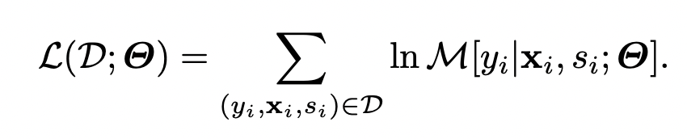


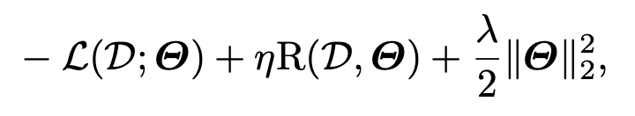
Framework
Focused on classification and built regularizers into logistic regression models
The parameters are tuned so as to maximize the log-likelihood :
Adopted two types of regularizers (1) a standard one to avoid over-fitting, used an L2 regularizer (2) to enforce fair classification
The objective function to minimize is obtained : (where λ and η are positive regularization parameters)

Slide 6

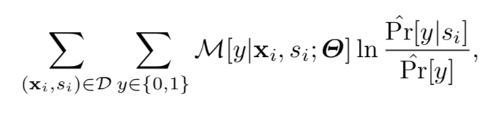
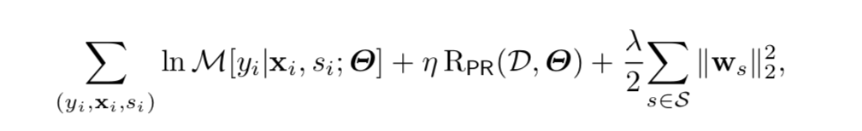
Framework
Logistic Regression
Prejudice Remover Regularizer ddis :
Objective Function
Minimize
Notes:
A prejudice remover regularizer directly tries to reduce the prejudice index and is denoted by RPR.
We focused on classification and built our regularizers into logistic regression models.
The conditional probability of a class given non-sensitive and sensitive features is modeled by M[Y |X, S; Θ], where Θ is the set of model parameters. These parameters are estimated based on the maximum likelihood principle; that is, the parameters are tuned so as to maximize the log-likelihood.

Slide 7
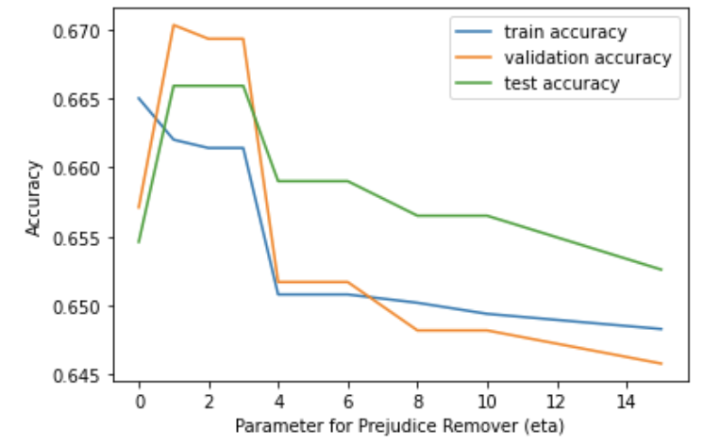
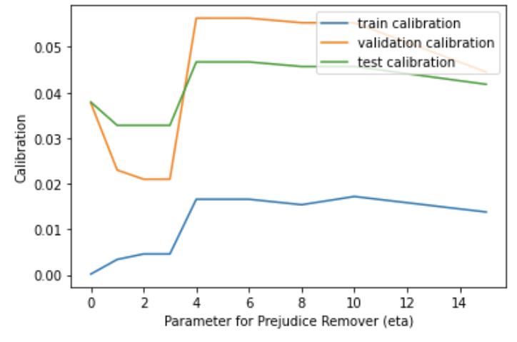
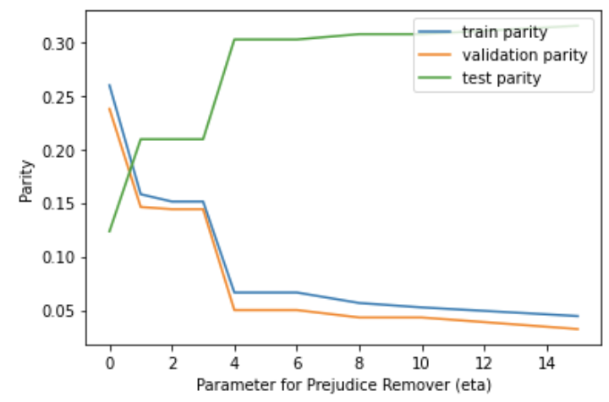
Model Evaluation
To compare with A7 paper, our first model chose 5 features same with A7.
We use 3 evaluation metrics: Accuracy, Calibration, Parity

Slide 8
Model Performance
To achieve high accuracy, low calibration and low parity, we decided to choose eta = 2.
Model | Prejudice Remover Regularizer |  |  | Logistic Regression
Evaluation | Training | Validation | Testing | Training | Validation | Testing
Accuracy | 0.6614 | 0.6693 | 0.6659 | 0.665 | 0.6571 | 0.6546
Calibration | 0.0046 | 0.021 | 0.0328 | 0.0002 | 0.0377 | 0.0379
Parity | 0.1512 | 0.1441 | 0.2093 | 0.2596 | 0.2376 | 0.1234

Slide 9
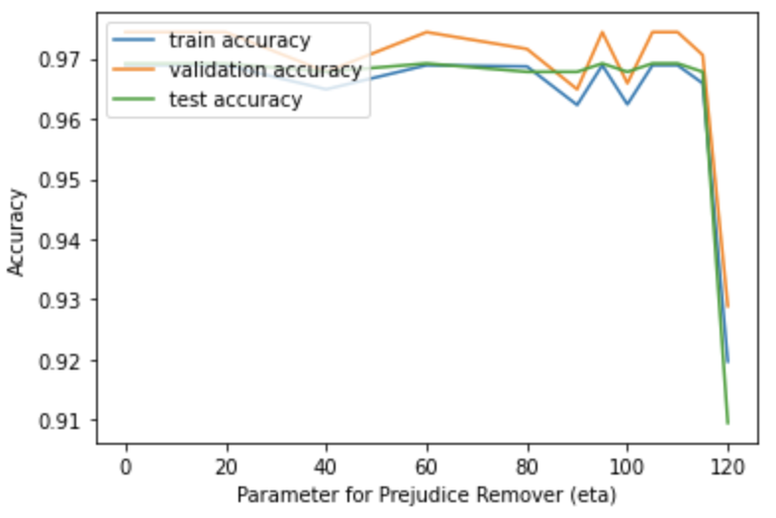
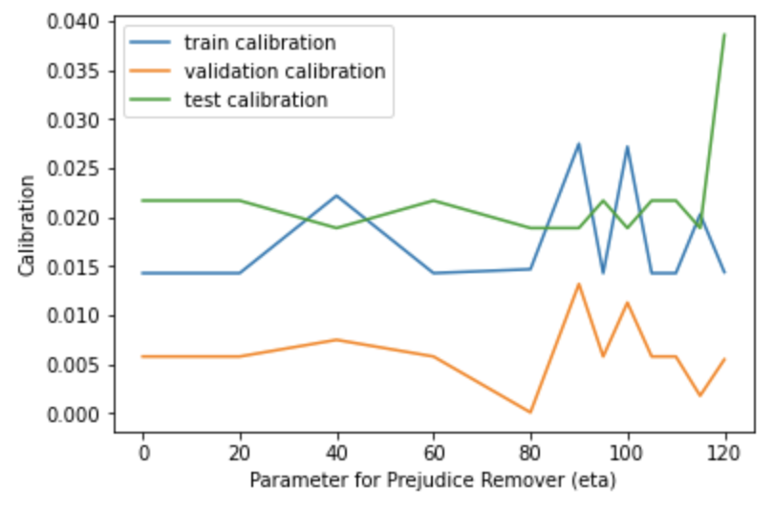
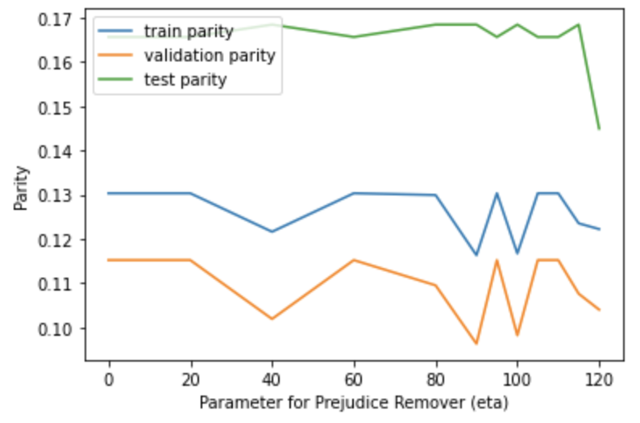
Model Evaluation
To get better performance, our second model chose different features based on correlation with Y.
We use 3 evaluation metrics: Accuracy, Calibration, Parity

Slide 10
Model Performance
To achieve high accuracy, low calibration and low parity, we decided to choose eta = 100, comparing with logistic regression with eta = 0.
Model | Prejudice Remover Regularizer |  |  | Logistic Regression
Evaluation | Training | Validation | Testing | Training | Validation | Testing
Accuracy | 0.9687 | 0.9716 | 0.9678 | 0.9689 | 0.9744 | 0.9692
Calibration | 0.0147 | 0.0001 | 0.0189 | 0.0143 | 0.0058 | 0.0217
Parity | 0.1299 | 0.1095 | 0.1684 | 0.1303 | 0.1152 | 0.1656

Slide 11
Summary
As eta increases, accuracy will decrease since it sacrifices for fairness, calibration will also decrease.
When we add prejudice remover regularizer, accuracy will decrease, calibration will also decrease.
For this problem, the fairness looks good (calibration below 5% for all models), so the prejudice remover regularizer does not work well.

Slide 12
Algorithm 2: Fairness-aware Feature Selection (A7)

Slide 13
Fairness-aware Feature Selection
The method is to develop a framework for fairness-aware feature selection based on correlation among features and the information theoretic measurements for accuracy and discriminatory impacts of features
Different from some other methods. The framework depends on the joint statistics of the data rather than a particular classifier design.

Slide 14
Fairness-aware Feature Selection
We first propose information theoretic measures which quantify the impact of different subsets of features on the accuracy and discrimination.
We then deduce the marginal impact of each feature using Shapley value function.
Finally, we design a fairness utility score for each feature (for feature selection) which quantifies how this feature influences accurate as well as non-discriminatory decisions.

Slide 15
FFS: Step 1
Accuracy coefficient on Subset of X:
Discrimination coefficient on Subset of X:

Slide 16
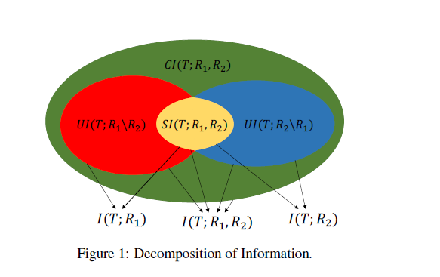
FFS: Step 1

Slide 17
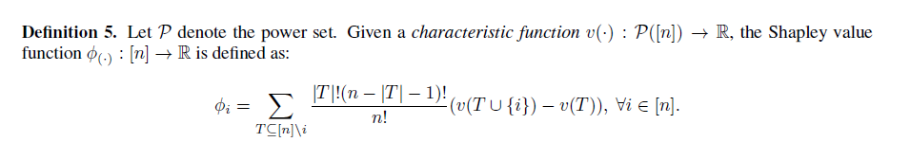
FFS: Step 2
As we calculated the accuracy and discrimination on subsets of X, we don’t know the correlation among the features. In order to account for this correlation, we need to factor in the aggregate effect of all subsets of features that include a certain feature. It leads us to the Shapley value function:

Slide 18
FFS: Step 3
Finally, we can get the accuracy and discrimination coefficients on each feature, and compare them to do the feature selection.
Fairness-utility score for a feature Xi is defined as F = acc - α*disc. Set α = 0.00125 in this case.
Notes:
.

Slide 19
Results
 | Feature | Accuracy | Discrimination | F
1 | Charge Degree | 1.046473 | 765.7377 | 0.089301
2 | Gender | 0.973917 | 729.6456 | 0.061860
3 | Age | 1.181441 | 939.7405 | 0.006765
4 | Prior Count | 1.229856 | 982.4314 | 0.001817
5 | Length of Stay | 1.028396 | 908.0171 | -0.10662
Same conclusion as paper shows.

Slide 20
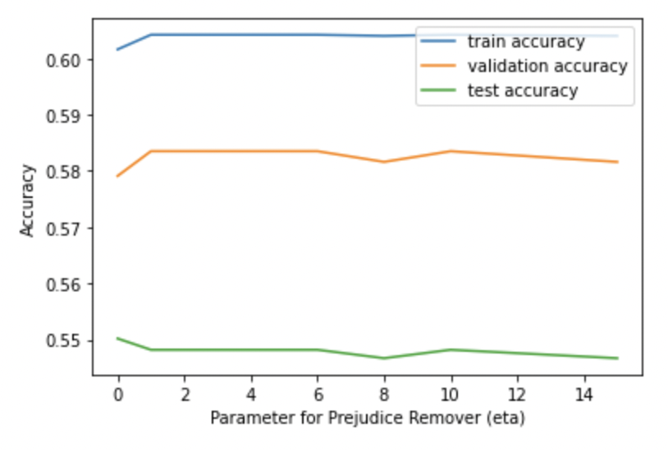
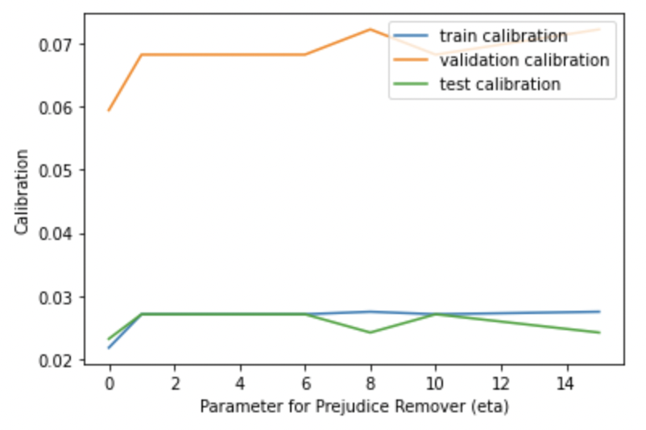
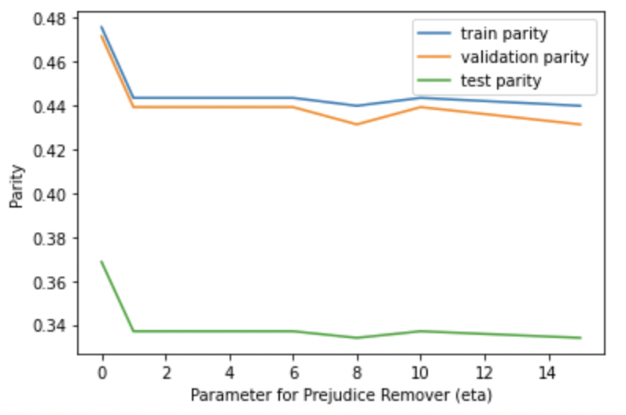
Compare A5 and A7
From the result of A7, we eliminate 2 most discriminative features: prior count and age and use the remaining 3 features.
We use 3 evaluation metrics: Accuracy, Calibration, Parity

Slide 21
Compare A5 and A7
To achieve high accuracy, low calibration and low parity, we decided to choose eta = 2.
Model | Prejudice Remover Regularizer |  |  | Logistic Regression
Evaluation | Training | Validation | Testing | Training | Validation | Testing
Accuracy | 0.6042 | 0.5853 | 0.5482 | 0.6016 | 0.5791 | 0.5502
Calibration | 0.0271 | 0.0682 | 0.0271 | 0.0218 | 0.0594 | 0.0232
Parity | 0.4435 | 0.4393 | 0.337 | 0.4758 | 0.4761 | 0.3687

Slide 22
References
Khodadadian, S., Nafea, M., Ghassami, A., & Kiyavash, N. (2021). Information Theoretic Measures for Fairness-aware Feature Selection. arXiv preprint arXiv:2106.00772.

